Slide 1

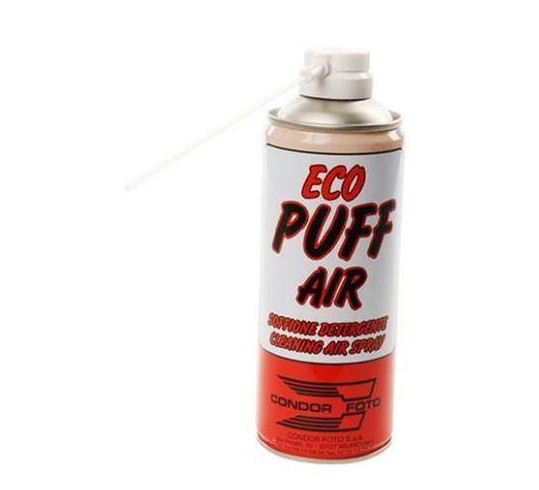
Technical Datasheet
ECO PUFF-AIR 400ml
Will instantly remove dust from lesser accessible places. Eco Puff-Air is a must have for cleaning lenses, delicate objects, computers, scanners and any mechanism sensitive to dust.
Eco Puff-Air contains no CFC and is ozone friendly.
Specifications:
Dimensions:
200 x 60 x 60mm
Weight: 400ml
Packaging: Canister
Additional Information:
Extremely flammable aerosol
Pressurised container: May burst if heated.
Protect from sunlight. Do no expose to temperatures exceeding 50 °C/122 °F.
_______________________________________
_____________
(fig.1) ECO Puff Air canister and
Velt House, Velt House Lane, Elmore, Gloucester, GL2 3NY
T: 01452 729903 E: info@mtfx.com www.mtfx.com

