Slide 1
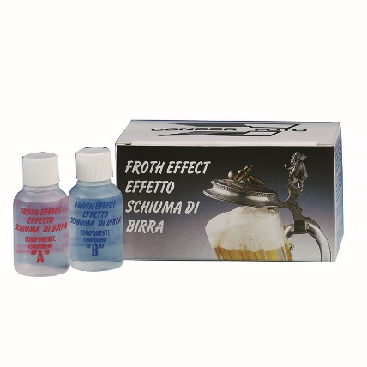
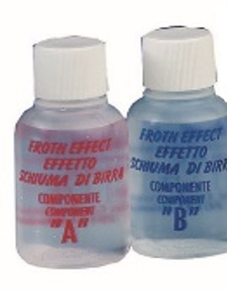
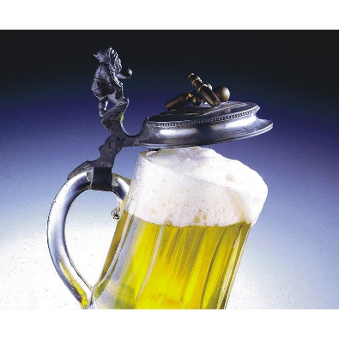
Technical Datasheet
Froth Effect
Create a fantastic frothy foam with the Froth Effect. Combine the two ingredients and stir for a few seconds to create a good amount of very realistic looking foam. Lasts for ages!
Each pack contains 4 doses.
The foam can then be poured or put on any product you like.
The result is fantastic, looks realistic and is perfect for any video production or photography piece where foam is required.
Specifications:
Dimensions: 2 x 30ml bottle per dose
___________________
Packaging: 4 doses per pack
___________________
Additional Information:
Avoid contact with eyes and skin
Wash hands thoroughly after handling
Wear protective gloves / eye protection / face protection
Do not ingest
Contains: POTASSIUM CARBONATE
(fig.1) Froth Effect
(fig.2) A + B Bottles
(fig.3) Beer froth
(fig.4) Coffee froth
Velt House, Velt House Lane, Elmore, Gloucester, GL2 3NY
T: 01452 729903 E: info@mtfx.com www.mtfx.com

