Slide 1
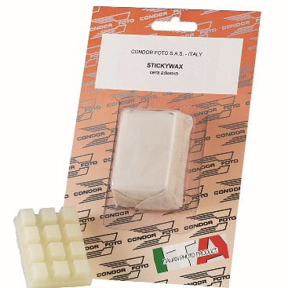
Technical Datasheet
Sticky Wax
A pliable wax adhesive – ideal for any fixing jobs that require small items to be held in place for photography purposes.
Can be reshaped and reused over and over again.
Specifications:
Dimensions:
200 x 80 x 20mm
Weight: tbc
Packaging: Blister pack
Additional Information:
Avoid contact with eyes
Do not ingest
_______________________________________
_____________
(fig.1) Sticky Wax
(fig.2)
(fig. 3)
(fig. 4)
Velt House, Velt House Lane, Elmore, Gloucester, GL2 3NY
T: 01452 729903 E: info@mtfx.com www.mtfx.com

